Slide 1


Slide 2
Introduction to Freepbx

Slide 3

Freepbx is a web based open source .
It can be installed manually .
General public license .
Freepbx is a trademark of Sangoma technoliges .
It is an open source communication server .
GUI (Graphical user interface ) .
Freepbx manages and controls Asterisk .

Slide 4
INTELLECTUAL PROPERTY OF FREEPBX

Slide 5
Freepbx is primarily released to public under the GPL
FreePBX provides a module system to allow plugging in 3rd party modules into your FreePBX system.
Any module that uses the FreePBX Module, Framework or GUI system must be released as GPL
Use of the module must be for controlling or managing other GPL or open source software.
Sangoma as the copyright holder does reserve the right to release modules that are not GPL and under a different license under a dual license model.

Slide 6
HOW IT GOT POPULAR

Slide 7
Feature loaded : Many more advanced add-ons are available .
Used by millions : Active installations and over 400 new installs per day .
Open platforms : It fully supports the ubiquitous SIP protocol .
Flexible deployment : It is available as a free download able software .
Future proof : There is a continuous stream of innovations making FREEPBX .
Backed by sangoma : Sangoma technologies is the main sponsor and the innovative source behind it

Slide 8
WHY IT
IS
SUCCESSFUL

Slide 9
It can be installed on our own server or virtual machine
It has a better design .
Protecting the privacy of the very young is especially important.
They do not collect or maintain information from .
To prevent unauthorized access, maintain data accuracy, and ensure the correct use of information

Slide 10
LICENSING MODEL

Slide 11
Sangoma Technologies (“Sangoma”) is the registered
owner of the U.S. federally registered trademark
FREEPBX (the “Trademark”),
Registration number 3365377.
Subject to the terms and conditions of this policy (the
“Policy”),
Sangoma grants you a non-exclusive, non-transferable,
royalty-free license to use the Trademark .
Reference to the software distributed through FreePBX.org
in its original form.

Slide 12
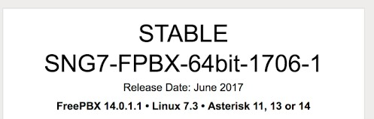

Slide 13
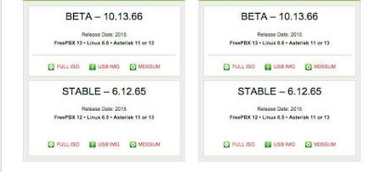

Slide 14
MONITORING
MODEL
OF
FREEPBX

Slide 15
It shows a variety of statical information about your system
How many calls are active.
How many trunks are active.
The Memory/Network usage.
The status of your Asterisk /MSQL (database) servers.
System uptime.

Slide 16
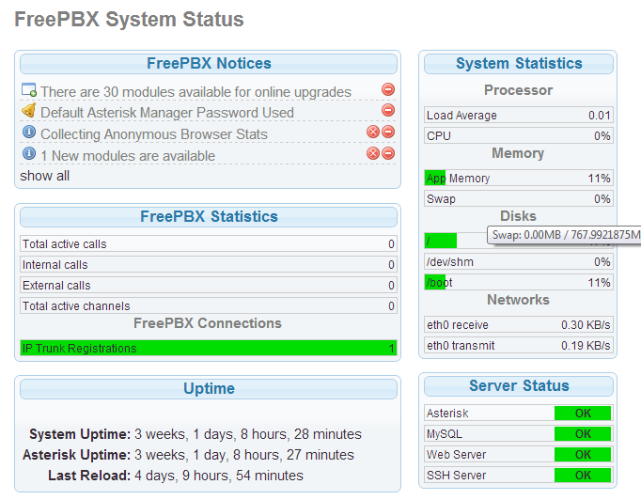
Freepbx system status

Slide 17
THank you

